Slide 1
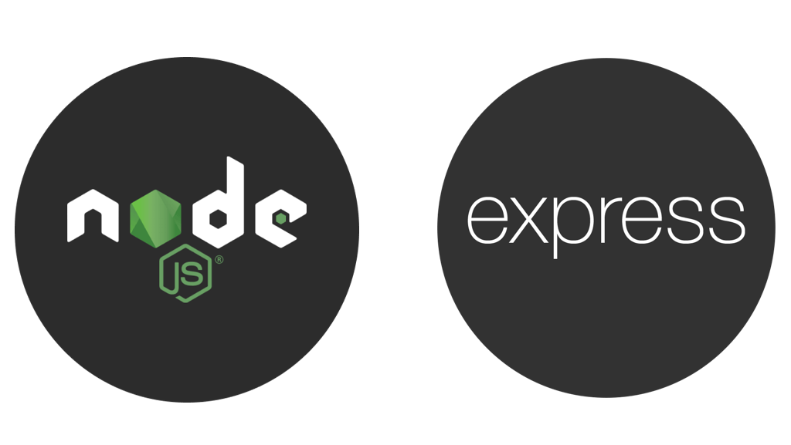

Slide 2
Introduction to Express Framework:
What is Express.js?
Express.js is a minimal and flexible Node.js web application framework that provides a robust set of features for building web applications and APIs. It simplifies server-side development by handling routing, middleware, and HTTP request/response management efficiently.
Why Use Express.js?
Lightweight & Fast: Minimal setup and optimized performance.
Middleware Support: Easily integrate third-party middleware for functionalities like authentication, logging, and error handling.
Routing System: Provides a robust and easy-to-use routing mechanism.
Scalability: Suitable for both small-scale and enterprise-level applications.
Template Engines: Supports various templating engines like EJS, Pug, and Handlebars.

Slide 3
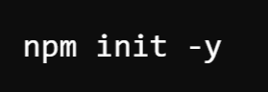

Express Server:
To start using Express.js, you need to have Node.js installed.
Step 1: Install Express.js
Initialize a Node.js project:
Install Express:

Slide 4
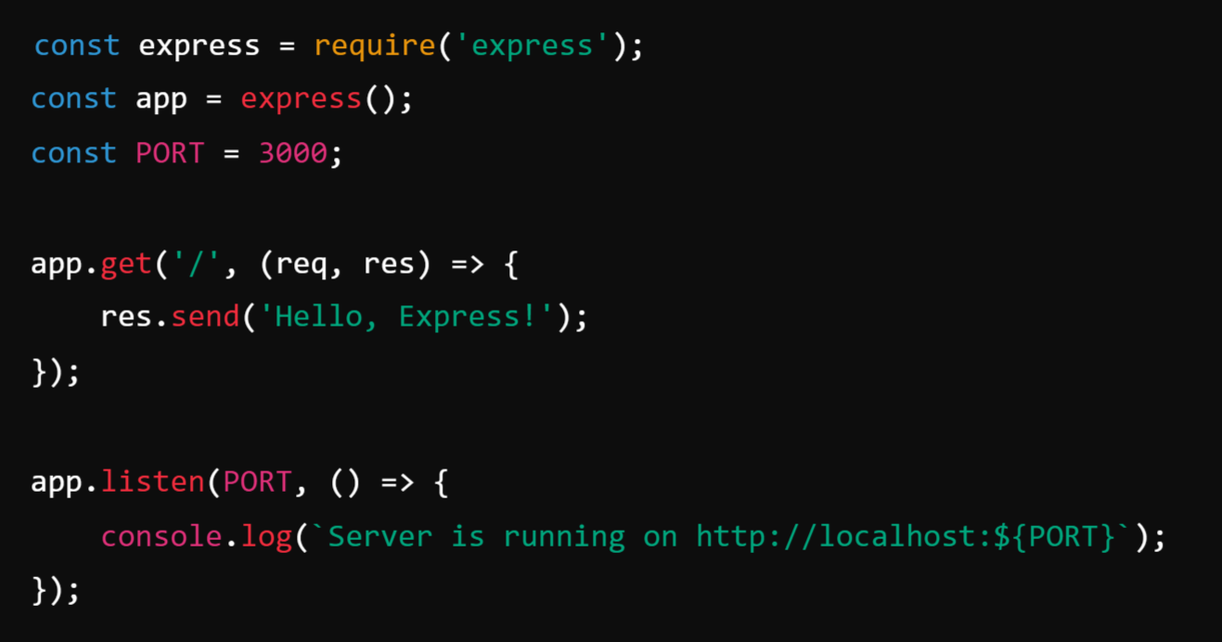
Step 2: Create a Simple Express Server
Create a file server.js and add the following code:

Slide 5
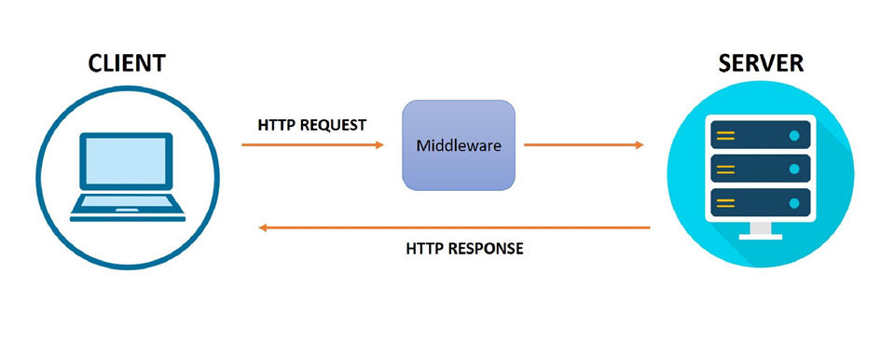
Request-Response Cycle in Express.js:
In Express.js, the Request-Response cycle refers to the process where a client (such as a browser or Postman) sends an HTTP request to the server, and the server processes it and sends back a response.
Use the req object to access the request details.
Use the res object to send a response back to the client

Slide 6
1. Request (req) in Express.js:
A request is sent by a client and contains important data, such as:
HTTP method (GET, POST, PUT, DELETE)
Request headers
URL parameters and query strings
Request body (for POST and PUT requests)

Slide 7
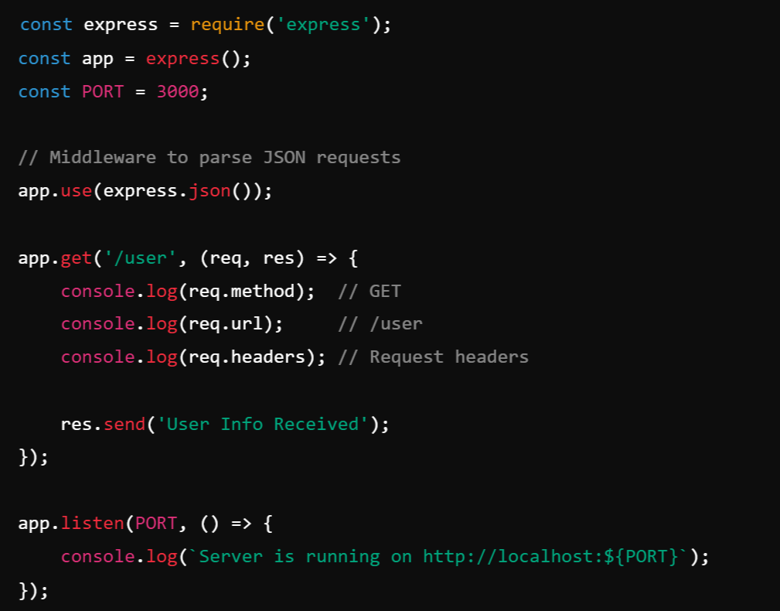
Example: Handling a Request

Slide 8
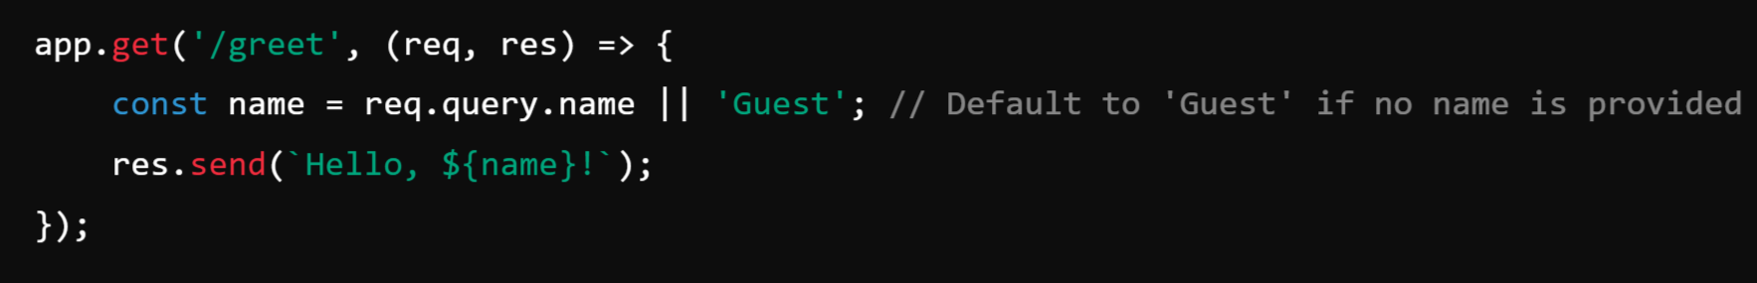
Types of Request Data
Query Parameters (req.query):
Query parameters are part of the URL and follow a ?key1=value1&key2=value2&keyn=valuen format.
URL Example: http://localhost:3000/greet?name=Pramod

Slide 9
How It Works
If the user visits http://localhost:3000/greet?name=Pramod, the response will be: "Hello, Pramod!"
If no name is provided, the response will be: "Hello, Guest!“
✅ Best for optional inputs like search filters and sorting options.

Slide 10
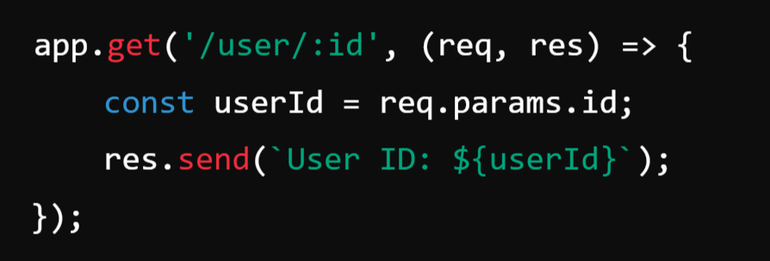
2. Route Parameters (req.params):
Route parameters are part of the URL path and defined with Colon (:) in routes.
URL Example: http://localhost:3000/user/123

Slide 11
How It Works
If the user visits http://localhost:3000/user/123,
the response will be: "User ID: 123“
✅ Best for required inputs like user IDs, order numbers, etc.

Slide 12
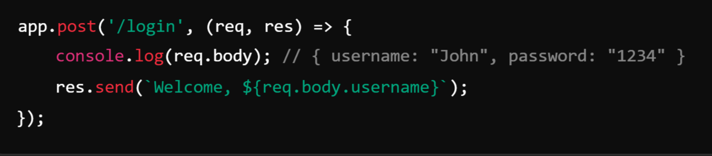
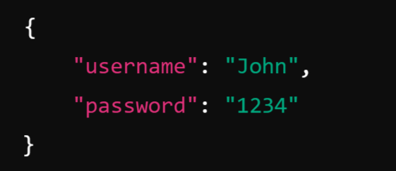
3. Request Body (req.body) - Used in POST and PUT requests
Post JSON Data Example (via Postman or frontend):

Slide 13
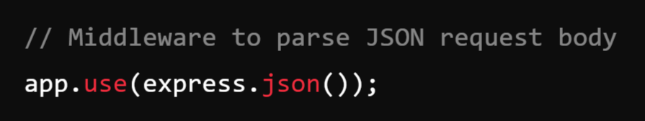
For POST and PUT requests, user input is sent in the request body.
Express does not parse the body by default, so we need to use express.json() middleware.

Slide 14
2. Response (res) in Express.js:
A response is sent by the server back to the client. It includes:
Status code (e.g., 200, 404, 500)
Response body (HTML, JSON, text, etc.)
Headers

Slide 15
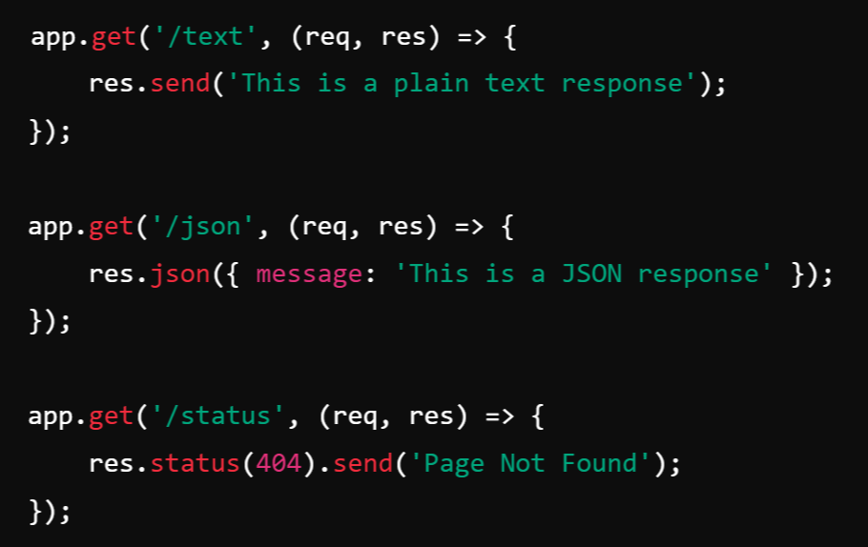
Example: Sending Different Responses

Slide 16
Routes in Express.js
What are Routes?
In Express.js, routes define how the server should respond to different HTTP requests (GET, POST, PUT, DELETE) for a specific URL path. Routes determine what happens when a client sends a request to the server.
Basic Route Handling: A basic route in Express consists of
HTTP method (GET, POST, PUT, DELETE)
URL path
Callback function (request handler)

Slide 17
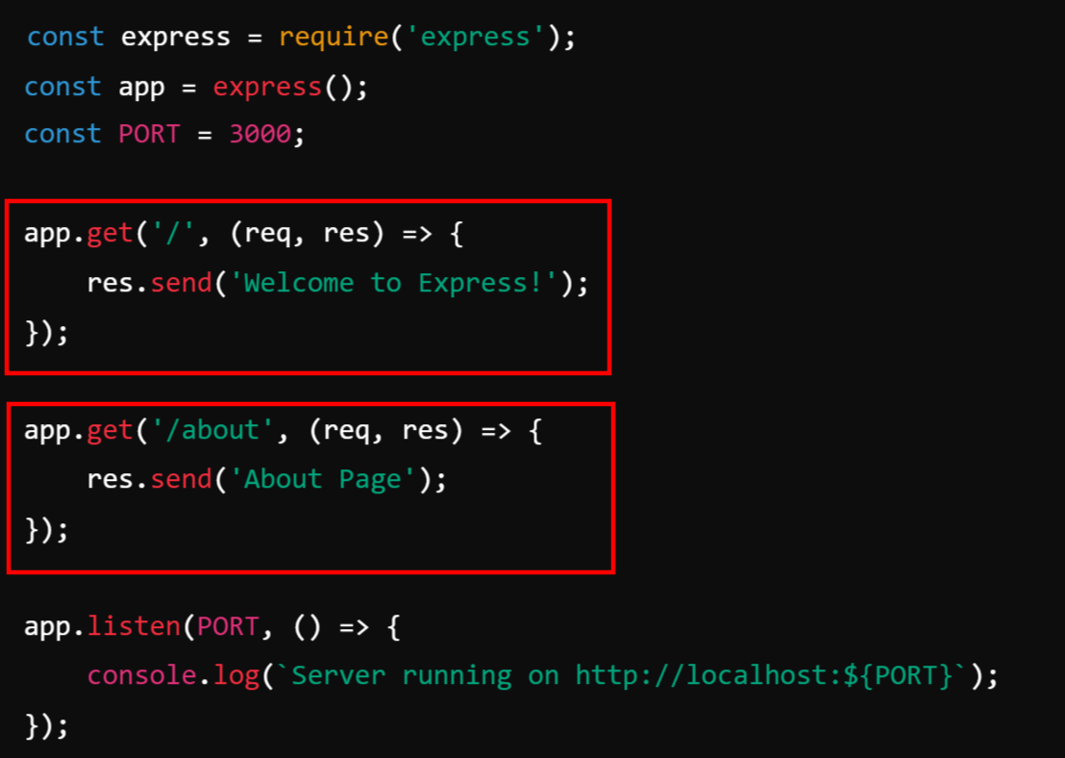
Example:
Simple Routes
📌 How it works:
GET / → Responds with "Welcome to Express!"
GET /about → Responds with "About Page"

Slide 18
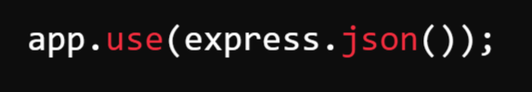
1. Handling POST Requests:
POST requests are used to send data to the server.
📌 Enable JSON Parsing Middleware:

Slide 19
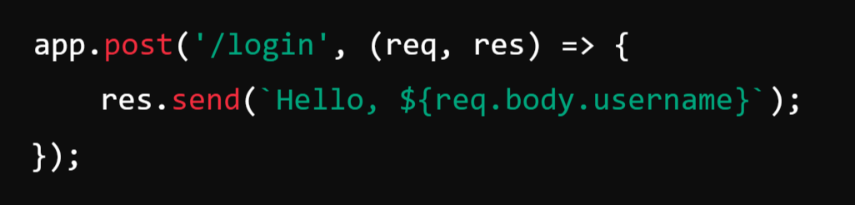
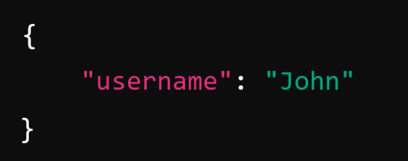
Example: Handling POST Request
📌 Example Request (Body in JSON format):

Slide 20
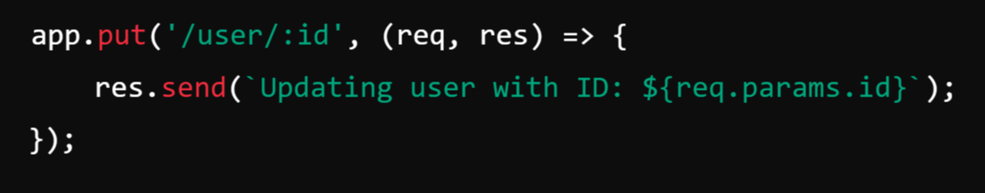
Handling PUT Requests: Used for updating data.
Example: Updating a User
📌 Example:
PUT /user/10 → "Updating user with ID: 10"

Slide 21
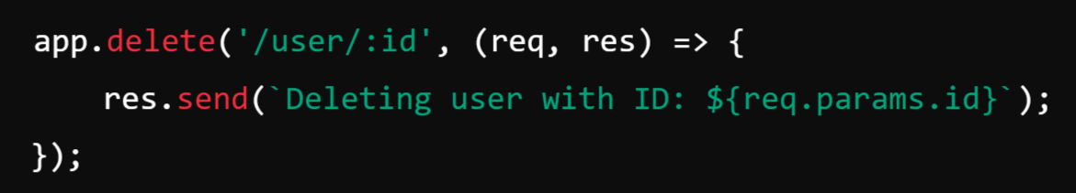
Handling DELETE Requests: Used to delete data.
Example: Deleting a User
📌 Example:
DELETE /user/10 → "Deleting user with ID: 10"

Slide 22
What are Route Parameters?
Route parameters in Express.js allow you to capture values from the URL and use them inside your route handlers. They are defined using a colon (:) before the parameter name in the route path.

Slide 23
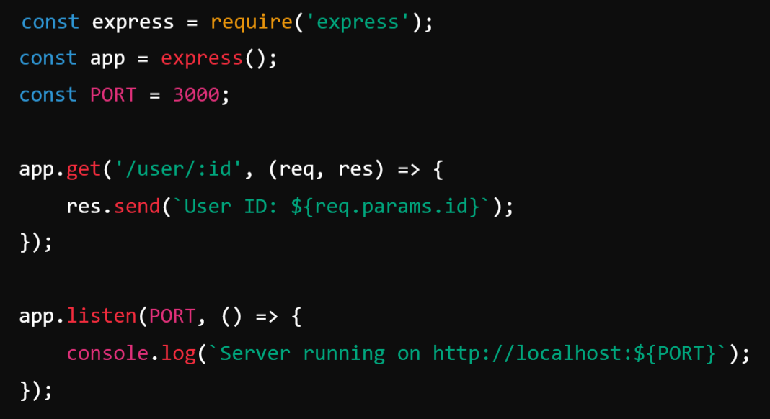
Example of Route Parameters:

Slide 24
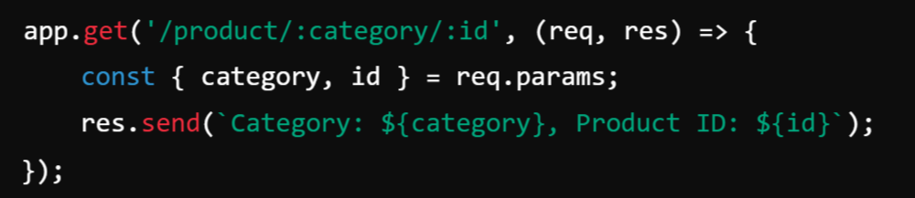
Accessing Route Parameters (req.params):
The req.params object contains key-value pairs of route parameters.
Example:
📌 Example Request:
GET /product/electronics/500 → Response: "Category: electronics, Product ID: 500"

Slide 25
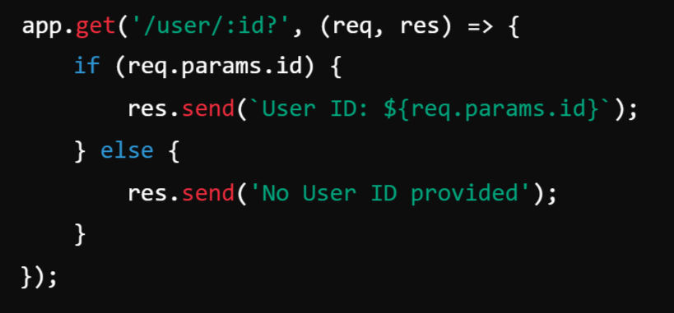
Optional Route Parameters:
You can make a parameter optional by adding a ? after the parameter name.
Example:
📌 Example Requests:
GET /user/123 → "User ID: 123"
GET /user/ → "No User ID provided"

Slide 26
Multiple Route Callback/Handler Functions:
In Express.js, you can use multiple callback (handler) functions in a single route to execute code sequentially.
This is useful for:
Middleware processing (e.g., authentication, validation).
Breaking down logic into smaller functions.
Error handling.

Slide 27
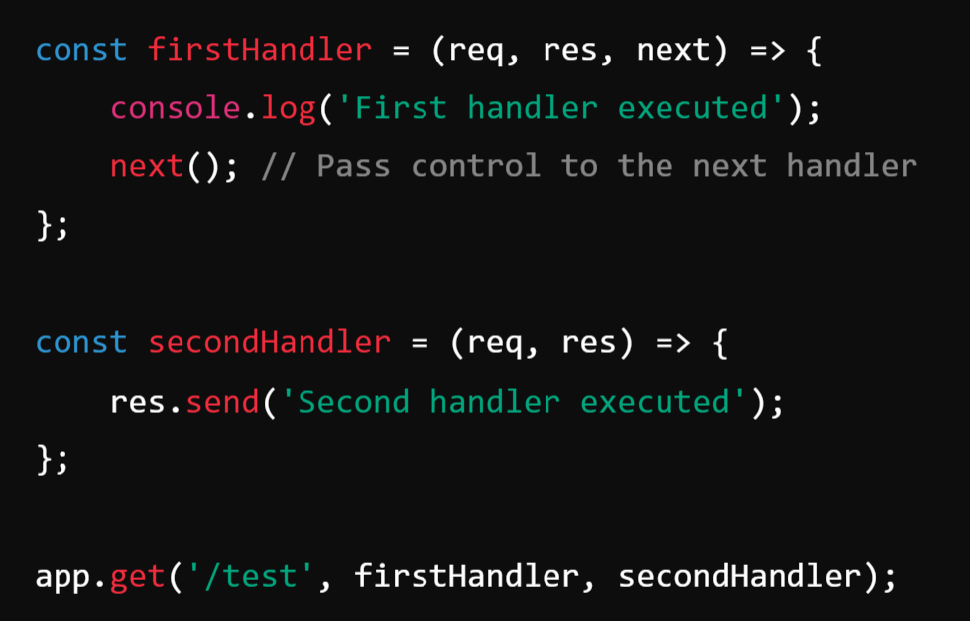
1. Using Multiple Callback Functions (Next Function):
Express provides the next() function to pass control from one handler to the next.
Example:

Slide 28
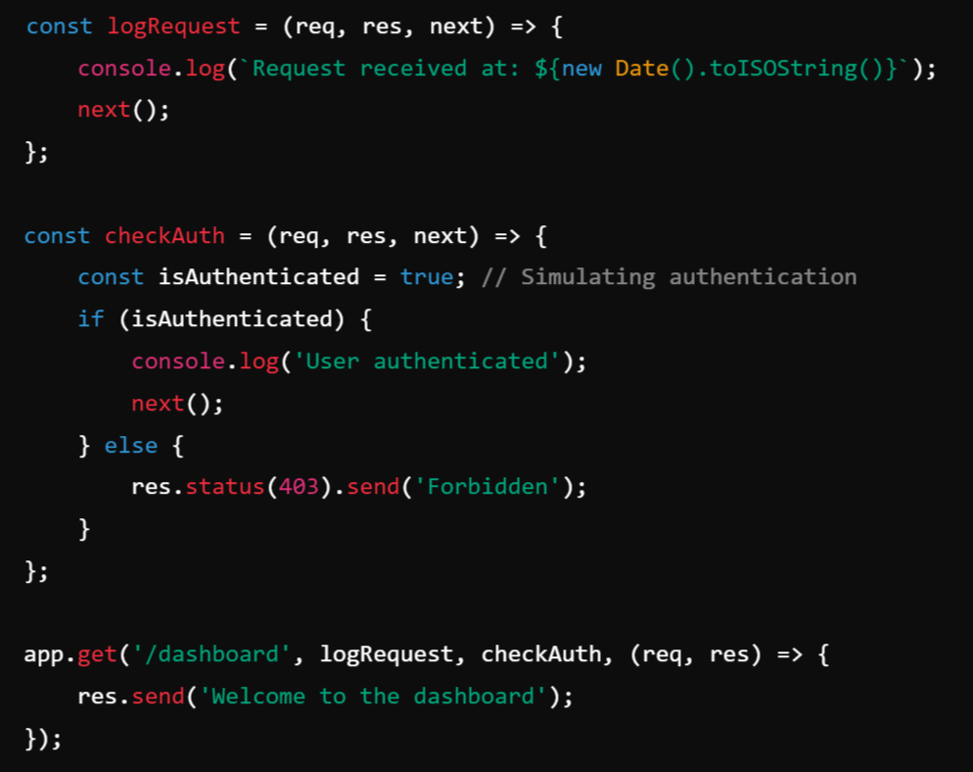
2. Multiple Middleware Functions in a Route:
Logging and Authentication Middleware

Slide 29
Methods of Response Object:
The Response (res) object in Express.js represents the HTTP response that an Express app sends to the client. It provides several methods to send responses in different formats, set headers, and modify status codes.
res.send()
res.json()
res.status()
res.redirect()
res.sendFile()
res.download()
res.set()
res.end()
res.render()
res.cookie()

Slide 30
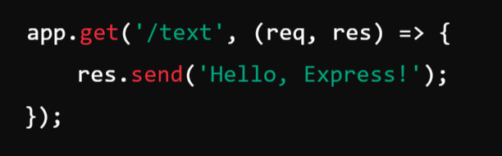
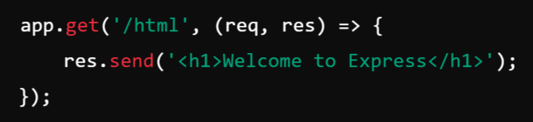
1. res.send() → Sends a Response (Text, HTML, JSON, Buffer)
The res.send() method sends a response to the client. It automatically detects the content type and sets the appropriate Content-Type header.
Example: Sending a Text Response
📌 Content-Type: text/plain
Example: Sending an HTML Response 📌 Content-Type: text/html

Slide 31
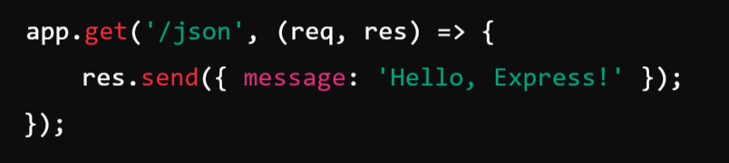
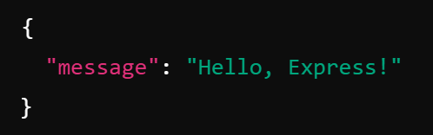
Example: Sending a JSON Response
📌 Response:
📌 Content-Type: application/json

Slide 32
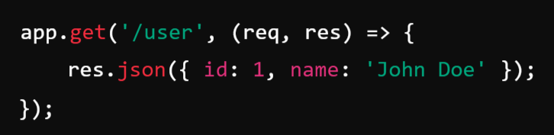
2. res.json() → Sends a JSON Response
The res.json() method is similar to res.send() but ensures the response is always JSON formatted.
Example: Sending a JSON Response

Slide 33
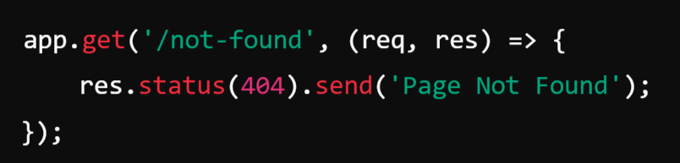
3. res.status() → Sets HTTP Status Code
You can set the HTTP status code before sending the response using res.status().
Example: Sending a 404 Response
📌 Response: "Page Not Found"
📌 Status Code: 404
✅ Use this method to indicate success (200), redirections (302), client errors (400, 404), or server errors (500).

Slide 34
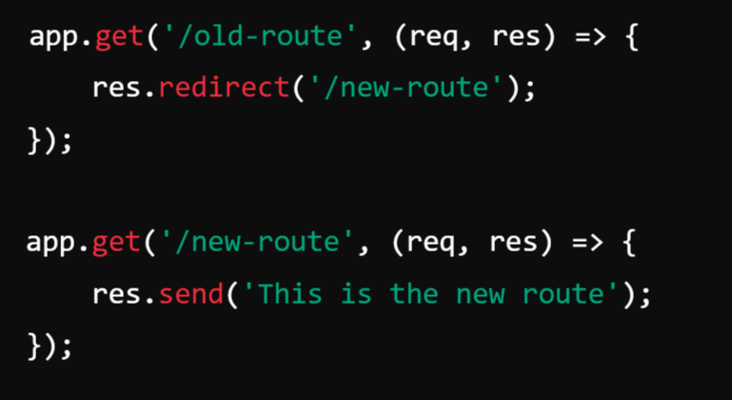
4. res.redirect() → Redirects to Another URL
The res.redirect() method sends an HTTP redirect response to another URL.
Example: Redirect to Another Page

Slide 35
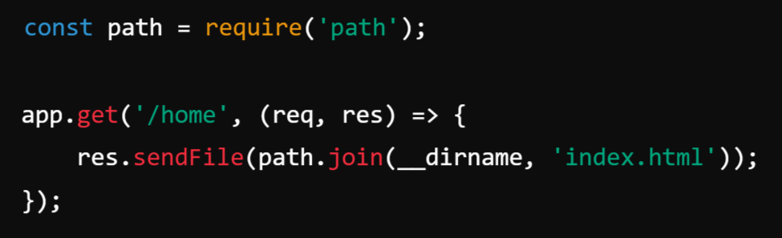
5. res.sendFile() → Sends a File
The res.sendFile() method is used to send files (e.g., HTML, images, PDFs) from the server.
Example: Sending an HTML File
✅ Use this method for serving static files like HTML, images, PDFs, etc.

Slide 36
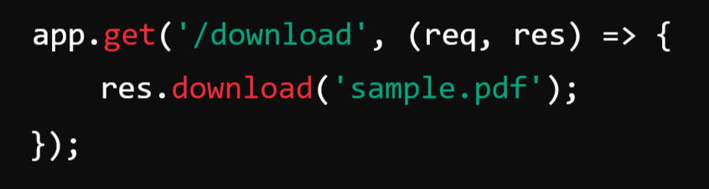
6. res.download() → Prompts File Download
The res.download() method allows users to download a file.
Example: Download a File
📌 Response: Prompts the user to download sample.pdf.
✅ Use this method when you want users to download files instead of viewing them.

Slide 37
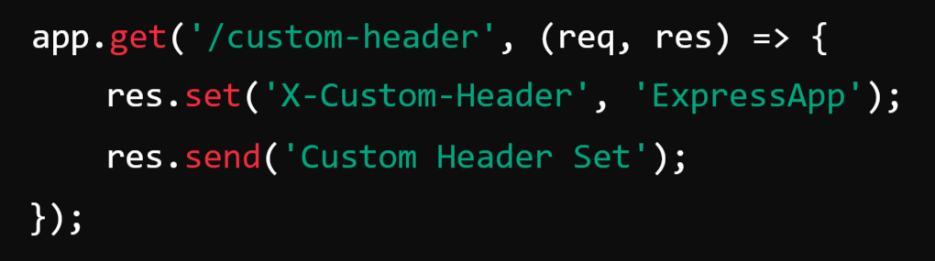
7. res.set() → Sets HTTP Headers
You can manually set response headers using res.set().
Example: Custom Header

Slide 38
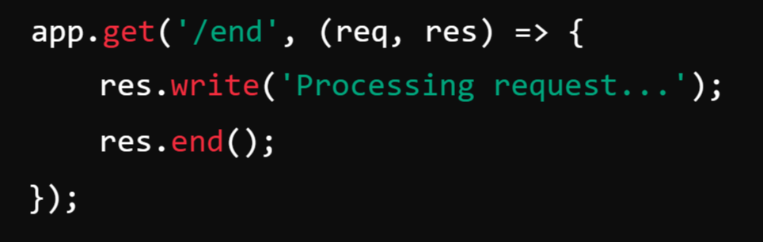
8. res.end() → Ends the Response
The res.end() method ends the response process without sending any content.
Example: Ending a Response

Slide 39
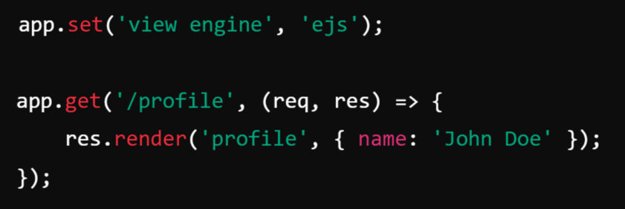
9. res.render() → Renders a Template (Used with Templating Engines)
If you’re using EJS, Pug, Handlebars, etc., you can use res.render() to render HTML views.
Example: Rendering an EJS Template

Slide 40
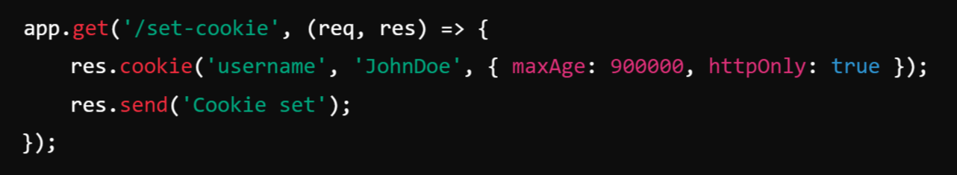
10. res.cookie() → Sets a Cookie
The res.cookie() method allows you to set cookies in the client’s browser.
Example: Setting a Cookie

Slide 41
Chaining Route Handlers:
What is Route Chaining?
In Express.js, route chaining allows multiple middleware functions or route handlers to be executed sequentially for a single request. This is useful when handling authentication, validation, logging, error handling, or breaking a complex route into multiple steps.
Chaining Multiple Middleware and Route Handlers
Express provides two ways to chain multiple handlers:
Using multiple callback functions in a single route.
Using app.route() for grouping routes with the same path but different HTTP methods.

Slide 42
1️⃣ Using Multiple Callback Functions in a Single Route
You can pass multiple middleware functions in a route, and they execute one after another.

Slide 43
Example:
Logging and Authentication Middleware
How It Works
logRequest logs the request URL.
checkAuth checks if the user is authenticated.
3rd Callback Function: Will send the Welcome to the dashboard to client.

Slide 44
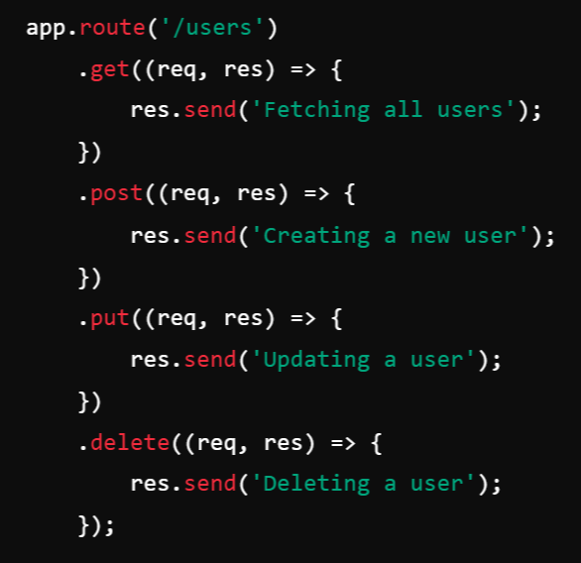
2️⃣ Using app.route() to Chain Handlers for the Same Path
When multiple HTTP methods (GET, POST, PUT, DELETE) share the same route path, we can use app.route() for better organization.
Example: Route Chaining for /users
How It Works:
HTTP Method | Route | Response
GET | /users | "Fetching all users"
POST | /users | "Creating a new user"
PUT | /users | "Updating a user"
DELETE | /users | "Deleting a user"

Slide 45
Sending Static Files:
Static files are files like HTML, CSS, JavaScript, images, fonts, and videos that do not change dynamically. Express.js provides a built-in middleware called express.static() to serve these files efficiently.

Slide 46
1️⃣ Using express.static() to Serve Static Files
The express.static() middleware maps a directory to be served as static content.
Example: Serving a public Folder

Slide 47
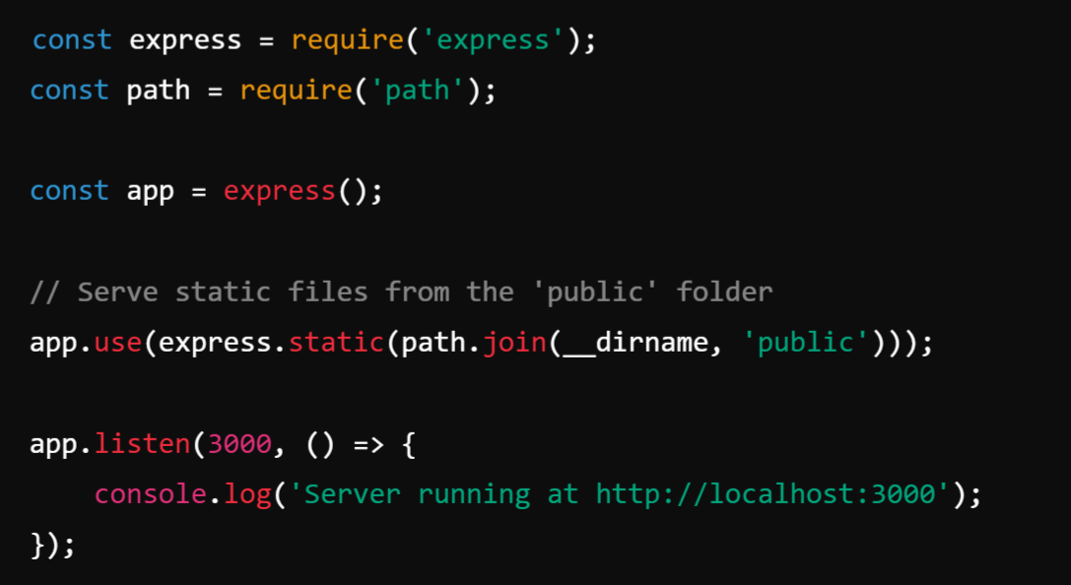

Slide 48
How It Works
express.static(path.join(__dirname, 'public')) makes everything inside the public folder available as static content.
The server will now automatically serve files like:
http://localhost:3000/style.css → public/style.css
http://localhost:3000/script.js → public/script.js
http://localhost:3000/image.png → public/image.png
✅ No need to manually define routes for static files!

Slide 49
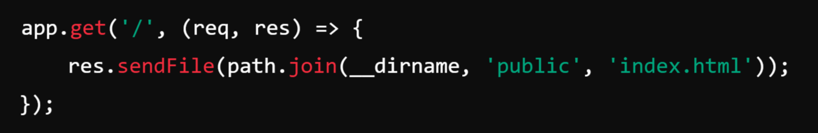
2️⃣ Serving a Specific File Using res.sendFile()
If you need to send a specific file manually, use res.sendFile().
Example: Sending index.html on Request
This ensures that when a user visits http://localhost:3000/, the server sends public/index.html.

Slide 50
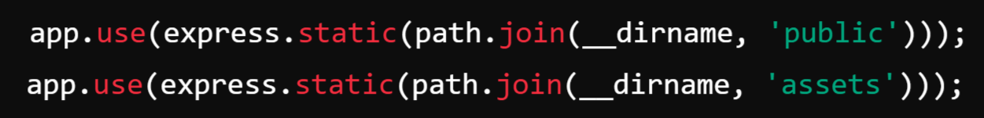
3️⃣ Multiple Static Directories:
You can serve multiple static directories by calling express.static() multiple times.
Now, files can be loaded from:
public/
assets/

Slide 51
Accept User Input:
In Express.js, user input can be received through query parameters, URL parameters, and request bodies. Below are different ways to handle user input.
Types of Request Data
Query Parameters (req.query):
Route Parameters (req.params):
Request Body (req.body) - Used in POST and PUT requests

Slide 52
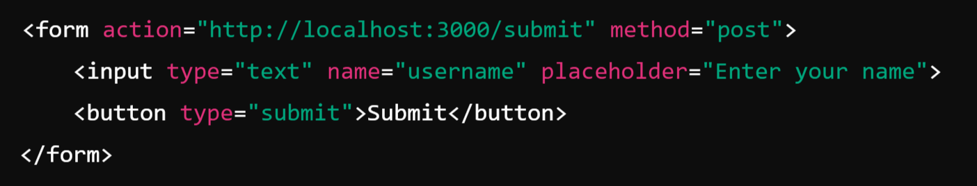
Accept User Input from HTML form:
📌 How Forms Work in Express.js
When a user submits a form, the data is sent to the server using an HTTP request (usually POST). The server then processes this data.
✅ Example: Handling Form Input in Express.js
1️⃣ Frontend (HTML Form)
The form sends data to /submit using a POST request.
The input field has name="username", so the submitted data will have a key named username.

Slide 53
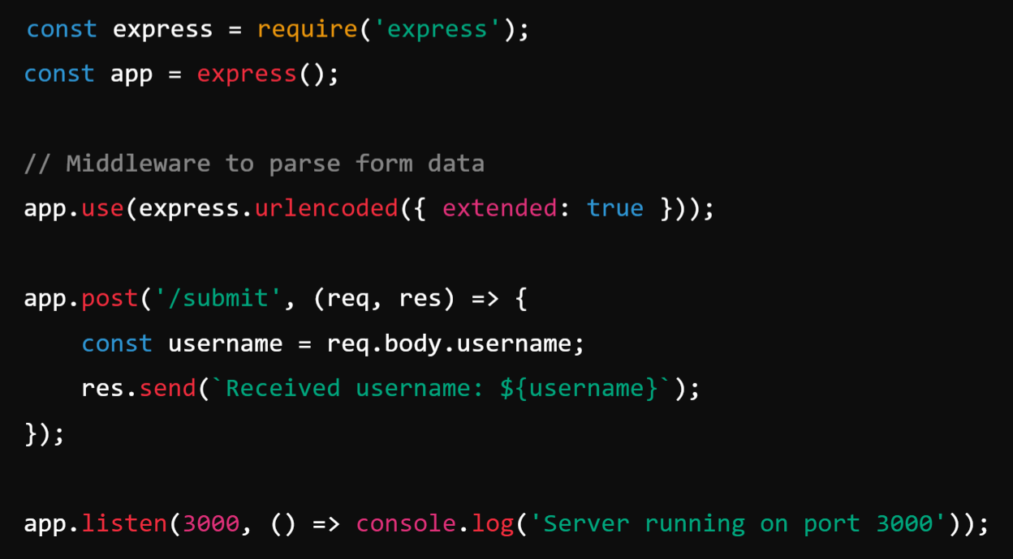
2️⃣ Backend (Express.js Server):

Slide 54
📌 Explanation
Frontend (Form)
The <form> tag has method="post", which means it sends data via a POST request.
The input field sends username as key-value data.
Backend (Express)
express.urlencoded({ extended: true }) is needed to parse form data.
req.body.username extracts the form input sent in the request.
The server responds with "Received username: {username}".

Slide 55

File Upload in Express.js
Express does not handle file uploads directly, but we can use the multer middleware to process them.
📌 Steps to Implement File Upload in Express.js
1️⃣ Install multer
2️⃣ Set up an Express server
3️⃣ Configure multer to handle file uploads
4️⃣ Create an API endpoint to upload files
5️⃣ Handle file storage and validation

Slide 56
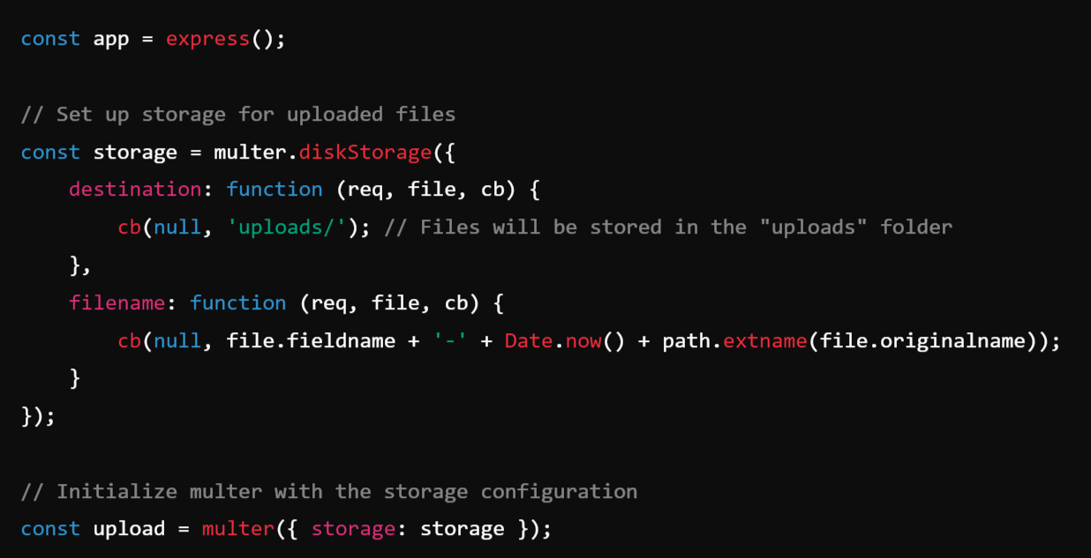
Create an Express Server: The cb (callback) function

Slide 57
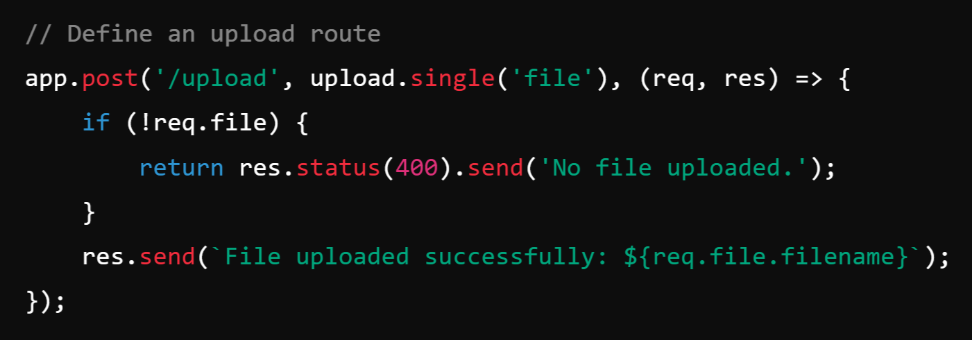
Create a /upload route:

Slide 58
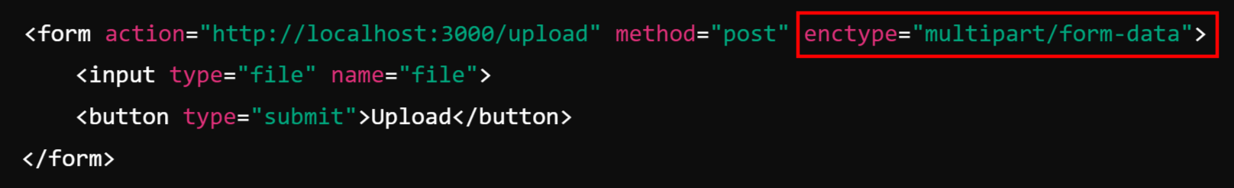
Frontend (HTML Form):
Explanation:
enctype (Encoding Type) specifies how form data should be encoded when submitting it to the server.
multipart/form-data is used when a form includes file uploads.
This encoding type ensures that the uploaded file is sent in multiple parts (separately encoded) instead of being converted into a single URL-encoded string.

Slide 59
📌 How It Works
1️⃣ Frontend Form Submission
The form sends a POST request to /upload with a file.
The enctype="multipart/form-data" is required for file uploads.
2️⃣ Backend Processing
multer.diskStorage() specifies where to store files (uploads/ folder).
multer() initializes file handling.
upload.single('file') means the server expects one file with the field name file.
The uploaded file is renamed with a timestamp to prevent overwriting.

Slide 60
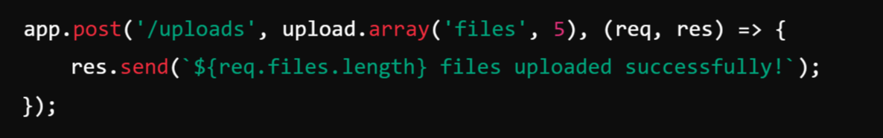

Handling Multiple Files
If you want to upload multiple files:
📌 In the HTML form, update:

Slide 61
📌 Sending a File as a Response in Express.js
In Express.js, you can use the res.sendFile() method to send a file as a response to the client.
This is useful for serving:
HTML files
Images
PDFs
Any static files

Slide 62
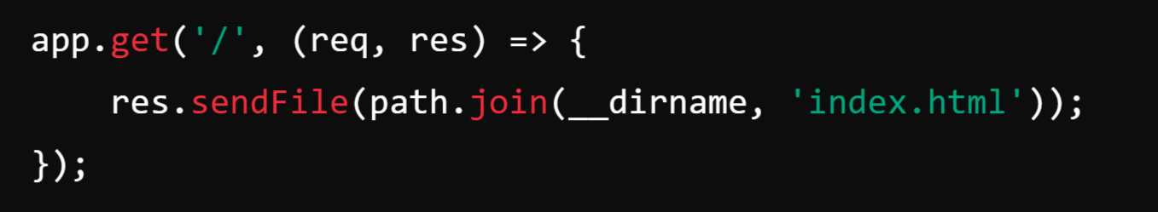
1️⃣ Basic Example: Sending an HTML File:
📌 Explanation
res.sendFile(path.join(__dirname, 'index.html')):
sendFile() __dirname → Refers to the current directory.
path.join(__dirname, 'index.html') → Constructs the absolute file path.
res. → Sends the file as an HTTP response.
📌 When the user visits http://localhost:3000/, the index.html file will be sent as a response.

Slide 63
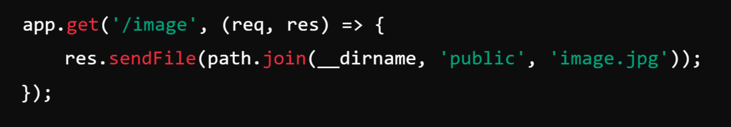
2️⃣ Sending an Image File:
📌 When the user visits http://localhost:3000/image, the browser will display image.jpg.

Slide 64
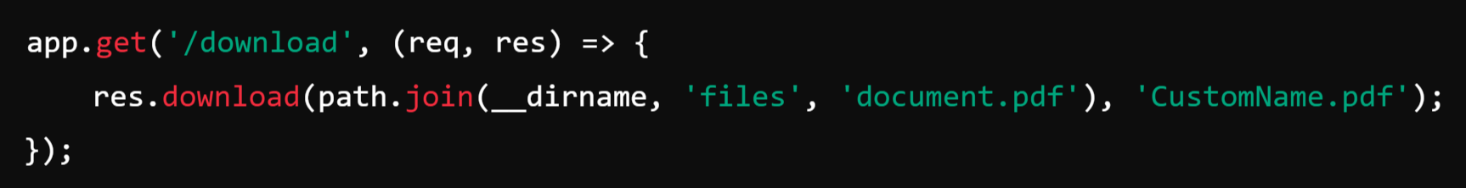
Forcing File Download Instead of Displaying
If you want the file to be downloaded instead of displayed, use res.download():
📌 This will prompt the user to download CustomName.pdf.

Slide 65
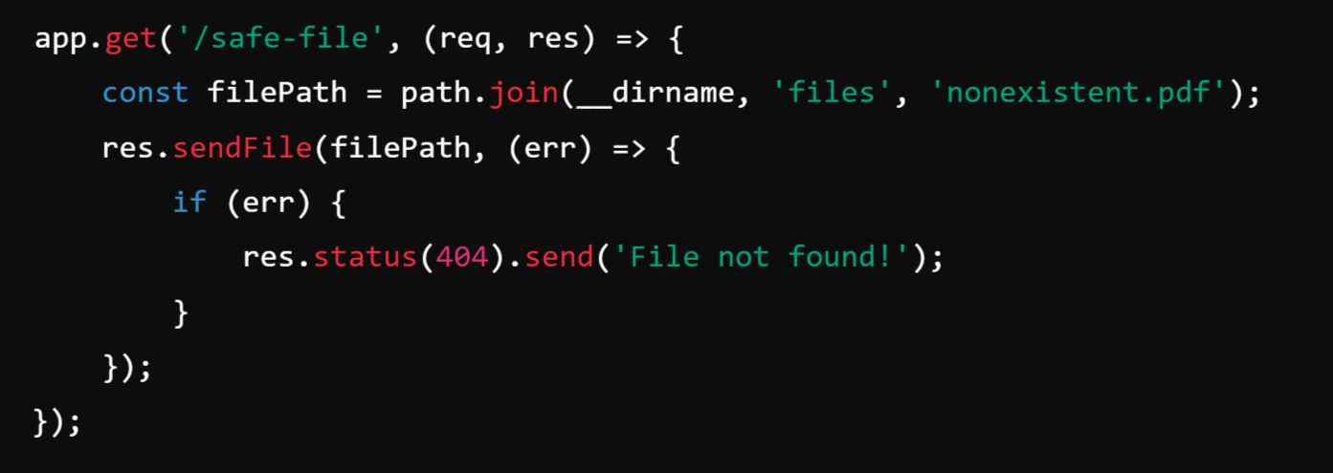
Handling Errors When the File is Missing
To avoid crashing when a file is missing:

Slide 66
Templates in Express.js
Templates in Express.js are used to dynamically generate HTML by embedding JavaScript code inside HTML files. This allows the server to send customized and data-driven responses to users.
Instead of sending static HTML files, Express can use template engines like EJS, Pug, or Handlebars to insert dynamic content, such as:
✅ Usernames
✅ Lists of products
✅ Data fetched from a database

Slide 67
EJS:
EJS (Embedded JavaScript) is a templating engine for Node.js that allows you to embed JavaScript code into HTML. It helps dynamically generate HTML pages based on data from your server.
How It Works:
<%= name %> → Outputs the value of name (HTML escaped).
<% %> → Executes JavaScript code (does not output).
<% items.forEach(...) %> → Loops through an array and displays list items dynamically.

Slide 68

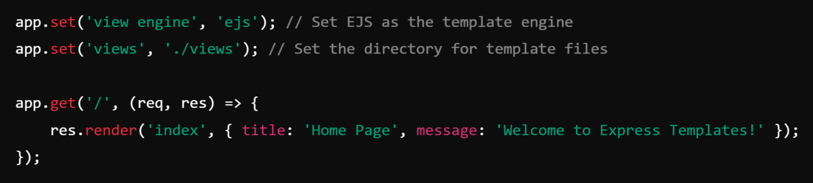
1️⃣ Setting Up a Template Engine in Express
Step 1: Install a Template Engine: Ex: ejs
Step 2: Configure Express to Use EJS
📌 Here, res.render('index', {...}) renders the index.ejs file inside the views/ folder.

Slide 69

Step 3: Create a Template File (views/index.ejs):
📌 <%= message %> injects the value of message from res.render().

Slide 70

2️⃣ Example with Dynamic Data (Passing an Array)

Slide 71

Create views/users.ejs:
📌 This will generate a list of users dynamically.

Slide 72


Slide 73
What Are Cookies?
Cookies are small pieces of data stored on a user’s browser by a website. They help in tracking user activities, maintaining session information, and personalizing user experiences.
How Cookies Work?
Creation: When a user visits a website, the server sends a Set-Cookie header in the response.
Storage: The browser stores the cookie and sends it with each request to the same domain.
Retrieval: The server reads the cookie to retrieve stored information.

Slide 74

Managing and Working with Cookies in Express.js 🚀
Express.js provides built-in support for handling cookies through the cookie-parser middleware.
How to set, read, and delete cookies in an Express:
1️⃣ Setup Express and cookie-parser:
Install Dependencies: First, install express and cookie-parser:

Slide 75

Create an Express Server (server.js):

Slide 76

2️⃣ Setting Cookies in Express
Using res.cookie()
You can set a cookie in Express using the res.cookie() method.\
🔹 Options Used:
maxAge: 86400000 milliseconds → Cookie expires in 1 day (24 hours).
httpOnly: true → Prevents JavaScript from accessing the cookie (helps against XSS attacks).

Slide 77

3️⃣ Reading Cookies in Express:
Using req.cookies:

Slide 78

4️⃣ Deleting Cookies in Express
Using res.clearCookie():

Slide 79
Note:
In a real-world scenario, users don't manually visit /set-cookie. Instead, cookies are usually set when a user logs in or performs some action that requires state management.

Slide 80


Real-World Example:

Slide 81
Alternative to Cookies: Local Storage & Session Storage
Feature | Cookies | Local Storage | Session Storage
Storage Limit | ~4KB | ~5-10MB | ~5-10MB
Expiry | Can be set | No expiry (unless deleted) | Cleared when the session ends
Accessibility | Sent with requests | Accessible via JavaScript | Accessible via JavaScript
Security | Can be vulnerable to XSS (Cross-Site Scripting) | Less vulnerable | Less vulnerable

Slide 82


Slide 83
What is an API?
API (Application Programming Interface) is a set of rules and protocols that allows different software applications to communicate with each other. It defines how requests and responses should be structured, enabling seamless data exchange between systems.

Slide 84


Slide 85
Example of an API:
Let’s say you are using a weather application on your phone to check the temperature. The app itself doesn’t generate the weather data; instead, it fetches data from a weather API, such as OpenWeather API.
How it works:
The mobile app sends a request to the API with a city name (e.g., Bangalore).
The API processes this request and fetches the weather details from its database.
The API sends the response back to the app in a structured format (usually JSON).
The app displays the weather details to the user.

Slide 86
Types of APIs:
REST API (Representational State Transfer) – Uses HTTP requests like GET, POST, PUT, DELETE.
SOAP API (Simple Object Access Protocol) – Uses XML messaging.
GraphQL API – Allows clients to request only the data they need.
WebSocket API – Used for real-time communication.

Slide 87



REST API:
REST (Representational State Transfer) is a web service that follows REST principles to enable communication between client and server
REST is an architectural style for designing networked applications. It relies on a stateless, client-server, cacheable communications protocol -- the HTTP protocol is most often used.

Slide 88
Why the Name REST?
The name "REST API" comes from the acronym "REST," which stands for Representational State Transfer. REST is an architectural style and set of constraints for building networked applications, particularly web services.
Here's a breakdown of the components that make up the name:
Representational: REST uses resources (such as data or objects) and their representations to interact with web services. A resource can be anything that can be named, such as a document, image, or database record. These resources are represented in a format that can be processed by the client, such as JSON or XML. Between XML and JSON, JSON is popular because it can be easily converted to JavaScript Object.
State: In REST, the state of the resource at any given point in time is transferred between the client and server. The client holds the current state of the interaction, and any changes to the state are sent to the server in a stateless manner. Each request from the client to the server must contain all the necessary informationserver does not store for the server to understand and process the request, as the any client context between requests.
Transfer: The transfer refers to the exchange of these representations between the client and server over a network, usually using the HTTP protocol. The client sends requests to the server, and the server responds with the resource representations.
Protocol: Set of Rules and Regulations for Data Communications.

Slide 89


Slide 90
Principles or Constraints of REST:
Statelessness:
Each request from client to server must contain all the information the server needs to understand and process the request.
The server does not store any client state or context between requests. This makes the client responsible for managing the state of the application.
Example: Every time a client requests user details, it must send an authentication token.
Client-Server Architecture:
The client and server have distinct roles: the client is responsible for the user interface and user state, while the server manages the application state and enforces constraints. This separation allows for independent evolution of the client and server components.
Example: A React frontend making a GET request to https://api.example.com/users, and the backend (Node.js, Django, etc.) responding with user data.

Slide 91

3. Cacheability:
Responses from the server must define themselves as cacheable or not to prevent clients from reusing stale or inappropriate data. This helps improve performance by reducing the number of client-server interactions.
Responses from the server should be cacheable to reduce redundant requests and improve performance.
APIs should define whether a response is cacheable using cache-control headers.
Example: A REST API response for product details can be cached:
👉 This tells the client/browser to cache the response for 1 hour (3600 seconds).

Slide 92
4. Uniform Interface: (Resources are identified In request through URI)
REST APIs should have a consistent structure that makes them easy to understand and use.
It follows standard HTTP methods:
GET → Retrieve data
POST → Create data
PUT/PATCH → Update data
DELETE → Remove data
Example: To get user details: GET /users/1
The uniform interface includes: Resource Identification: Resources (such as data or services) are identified using URIs (Uniform Resource Identifiers).

Slide 93
5. Layered System:
The API can have multiple layers (security, caching, load balancing) that do not interfere with each other.
The client does not need to know if it is communicating with the actual server or an intermediate layer (e.g., a proxy, CDN).
Example: A request might go through:
Load balancer
Authentication server
Main application server
Database
The client only interacts with the API endpoint, unaware of these layers.

Slide 94
6. Code on Demand (Optional)
REST allows servers to send executable code (e.g., JavaScript) to the client, which can run dynamically.
This is optional and not used in most APIs.
Example: A REST API could send a JavaScript script that executes on the client’s browser to improve functionality.

Slide 95
Why is it called REST?
The name comes from the idea that:
"Representational" → The client interacts with representations of resources (e.g., JSON, XML).
"State Transfer" → The state of the resource is transferred between client and server using HTTP methods (GET, POST, etc.).
Breaking it Down:
Representation → When a client requests a resource, the server sends a representation of that resource (e.g., JSON response for user data).
State Transfer → The client does not store state; instead, each request carries all the necessary information.

Slide 96

Install Postman

Slide 97

Create Database Table and Insert the Rows:

Slide 98

1. Get all articles:

Slide 99

2. Make a specific Get request (Get Specific Article☺)

Slide 100

3. Post a new article

Slide 101

4. Put operation on a specific record

Slide 102

5. Patch request

Slide 103

6. Delete request

Slide 104

7. Deleting a specific record

Slide 105

Authentication and Security

Slide 106
🔑 1. What is Authentication?
Security is a critical aspect of API development to protect data and prevent unauthorized access.
Authentication is the process of verifying the identity of a user or system. It ensures that users are who they claim to be.
Common Authentication Methods in Node.js:
Username & Password login (Form-based)
Token-based authentication (JWT)
OAuth (Google, Facebook, GitHub Login)
Session-based authentication (using cookies)

Slide 107
🔒 2. What is Security in Node.js?
Security in Node.js refers to protecting the application from various vulnerabilities and attacks such as:
SQL Injection
Cross-Site Scripting (XSS)
Cross-Site Request Forgery (CSRF)
Brute Force Attacks
Common Node.js Security Practices:
Input validation and sanitization
Using HTTPS
Secure session management
Password hashing (bcrypt)
Setting secure HTTP headers (Helmet.js)

Slide 108
7 Mark Questions:
Explain the role of the Express framework in Node.js development. How does Express simplify the process of creating web applications?
Discuss the concept of routes in Express. How are routes defined and used to handle different types of HTTP requests?
Explain the use of route parameters in Express. How can you extract and use route parameters in your route handlers?
Describe the concept of middleware in Express. How can you use middleware to perform tasks such as logging, authentication, and error handling in your Express applications?
Discuss the use of cookies in Express. How can you manage cookies in your Express applications to store and retrieve user-specific information?
Explain how you can accept user input in an Express application. How can you use forms to collect data from users and process it in your routes? Explain the role of the Express router module.
Describe the process of making a specific GET request in an Express application.

Slide 109
10 marks:
Describe the process of uploading files in an Express application. How can you handle file uploads using middleware such as multer?
Explain the concept of RESTful API design. What are the key principles of REST, and how can you implement them in an Express application? Provide examples of GET, POST, PUT, PATCH, and DELETE HTTP requests using the Express framework.

